Slide 1
ArachnoBeea
• Product: How well does this project fit the needs of the challenge it addresses? How user friendly is the technology? Is it a complete solution or does it have a long way to go?• Sustainability: How good is the plan for next steps? How prepared is the projectteam to continue their work beyond the event? Is the project organized in a way so others can take the project to the next level?• Presentation: How well did the team communicate their project? Are they effective in telling the story of the project and why it is important?

Slide 2
Impact
The impact that we will produce will be on the all aspects of life on space station.
Robot/Drone will be helping about many things like repairs, building new stuff and, of course, carrying things around
Also, this system could have an impact on inventory management system on space station
How would that make everyone feel (not having to worry about “Earthly” stuff and just do cool, scientific stuff)?

Slide 3
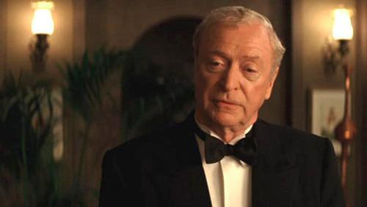
Like BATMAN! Because everyone will have their own friendly little Alfred!

Slide 4
Creativity
How creative were we?
Well, this little robot is using abundance of tech that is already there, but in a slightly new way.
And a way that, in the future can show to be scalable, maintainable and easily upgradable.
Main creative idea is that by adding legs with modular ending plug-ins we created a unmanned vehicle that, unlike the quad-copter drone, can work in environment that has no atmosphere (Like de-pressurized module on space station)!
Also by modifying the grappler leg, you can give it a possibility to do other tasks like soldering, welding, screwing things...

Slide 5
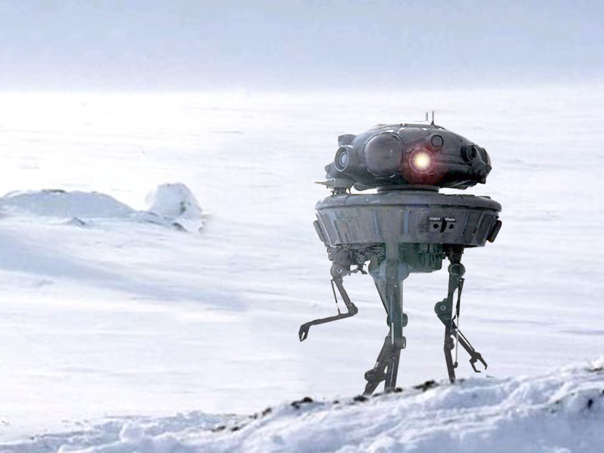
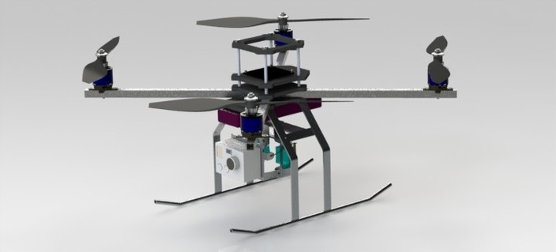
We went STAR WARS on this challenge :)

Slide 6
Product
To answer this question I will try to go through the main “phases” that our product will have to go through in order to solve the problem at hand
Locating the cargo
Planning the route
Flight control / collision avoidance
Homing on the object
Grabbing the object
Where to take it?
Additional problems that we solve (non pressurized environment, other tasks)

Slide 7
Sustainability
Documentation built is high level design
We gave hints on how to continue with the design
We gave, in documentation, concrete solutions on some of the problems
We have multidisciplinary team that had already worked with projects/problems that deal with problems that appear in this project as well

